Slide 2
NEAT
Neuroevolution of augmenting topologies
Direct encoding
Mating
Solution for TWEAN problems
  Meaningful crossover
  Protects innovations (niching)
  Search for minimized topologies
No Schrittweitenadaption
Possible elitism

Slide 3
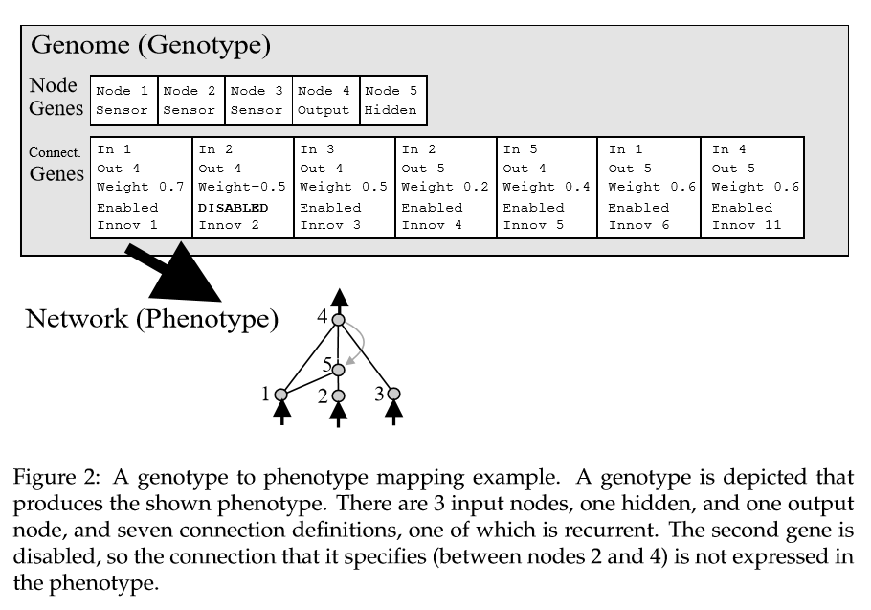
Encoding

Slide 4
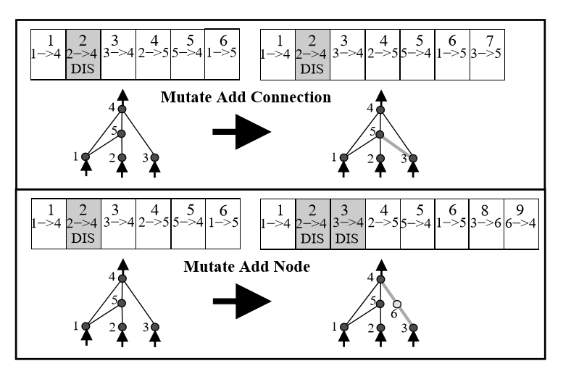
Mutation
Additional weight mutation

Slide 5
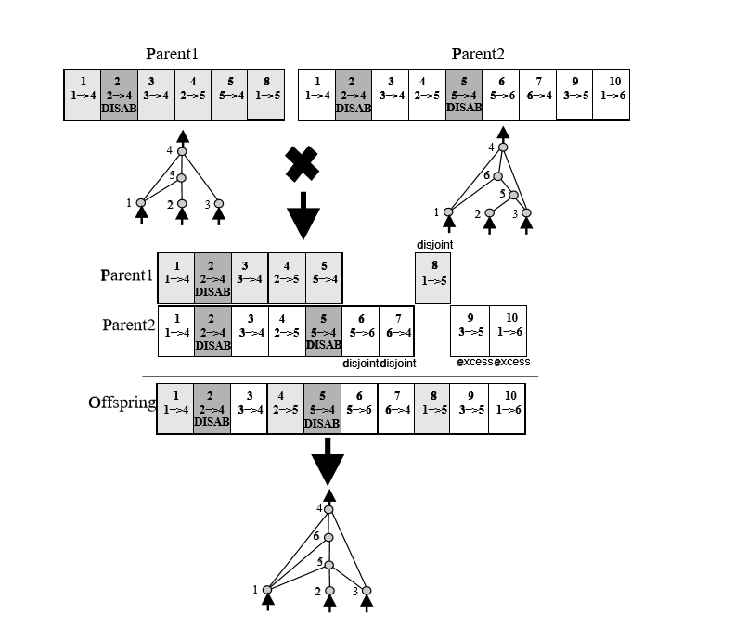
Mating

Slide 6


Specitation (Niching)
Explicit fitness sharing
Reproduction: number of children of a Species proportional to summed fi’ of it’s individuals.

Slide 7
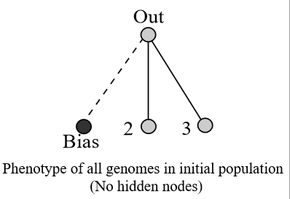
Minimizing dimensionality through incremental growth form minimal structure
Starting with only bias, input, output connected.
Search space (number of weights+1) increases by adding nodes or connections

Slide 8
Hyperneat
Beispiel Tafel

Slide 9
Hyperneat
= Hypercube-based neuroevolution of augmenting topologies
Indirect coding of connections
  Nature: 30,000 gene → 100*10^9 Neuron
    Function f R^4→[a,b], (x1,y1,x2,y2)→ y
                Position Neuron1,2
    If y > Threshold than connection. Weight scaled between y and b
Scalability, without new learning
Suitable for networks with up to millions of neurons
Includes spatial position and relations of neurons into the search process
Searches only ConnectionSpace not NeuronSpace ->no topologies.

Slide 10
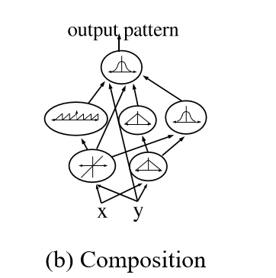
cCPPN
Connective Compositional Pattern Producing Networks
Connectivity function f = CPPN
Produces spatial patters by combination of basic functions: E.g sinus,lines, gaussians...
Describes searched ANN
Gets evolved by NEAT

Slide 11
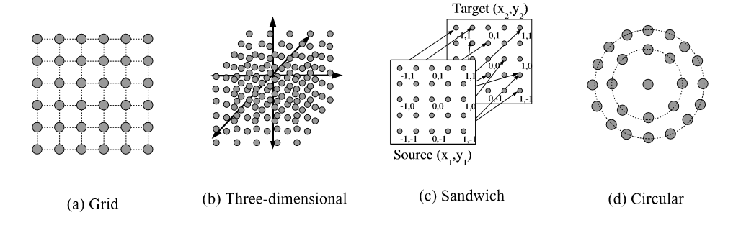
Substrate
Position of Neurons in Space
Can encode relationship between neurons

Slide 12
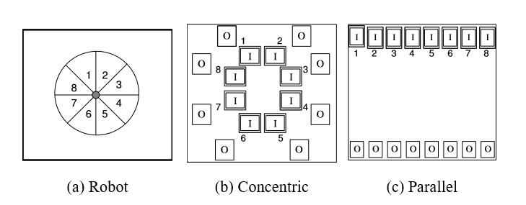
Substrate

Slide 13
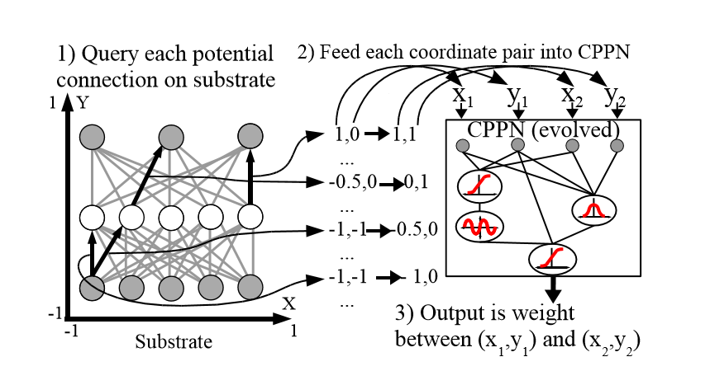
Query Substrate

Slide 14
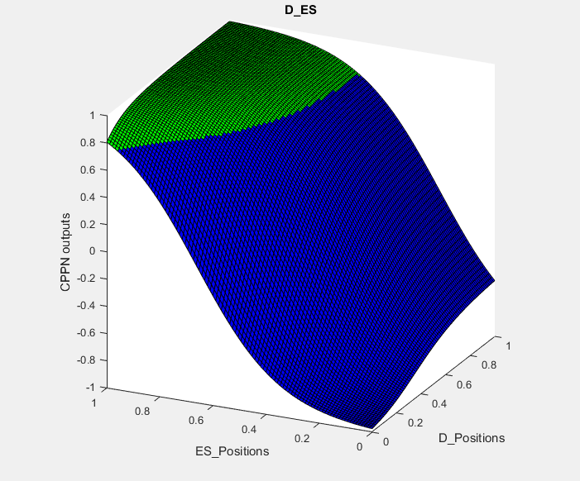
CPPN Output with 1D Substrate

Slide 15
HyperNeat algorithm
Population with minimal CPPNs and random weights
repeat:
  for each member
    → query substrate
    → get ANN
    → determine fitness of ANN
  Reproduction with NEAT

Slide 16
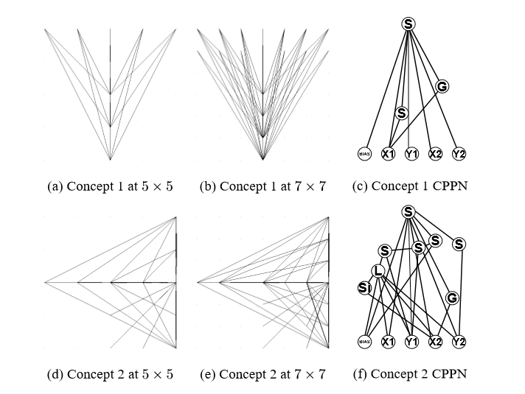
Scalability

Slide 17
ES-HyperNeat
Evolvable Substrate HyperNeat
Output of CPPN is now “language” that describes whole network
Basic Idea: Variance follows information.
  Area with uniform weights code little information (questionable!!!, but works)
  Connections and their nodes are created for each band with different weight values.
Input and Output Neurons have to be given. Hidden neurons determined.

Slide 18
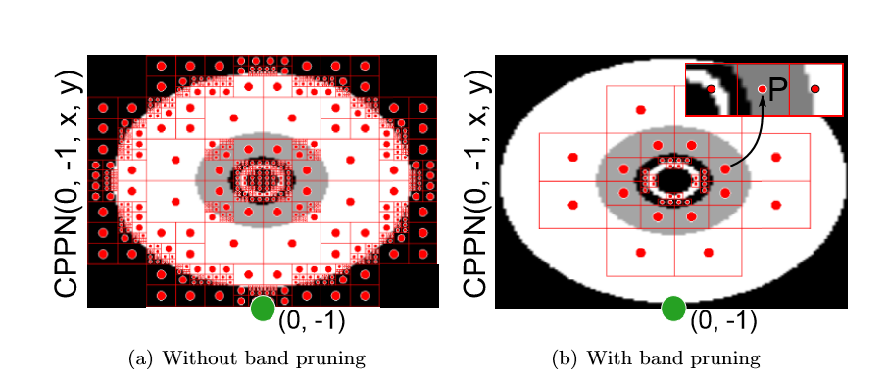
Result

Slide 19
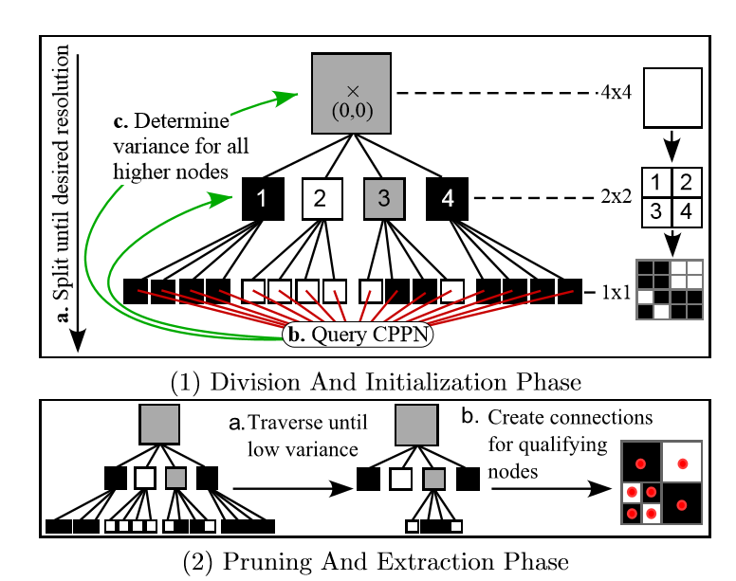
Quadtree and pruning step 1

Slide 20
Pruning step 2
horizontal or vertical neighboring band
on both sides

Slide 21
Algorithm
For each input neuron build 2d CPPN by fixing coordinates of input neuron (x1,y1). -> search for connections and their nodes-> realize them.
Do this again for each found neuron
Repeat until no new neurons are found
For each output neuron build 2d CPPN by fixing coordinates of output neuron (x2,y2). -> search for connections and their nodes-> realize node if node is existing
Delete non output nodes without outgoing connections

Slide 22
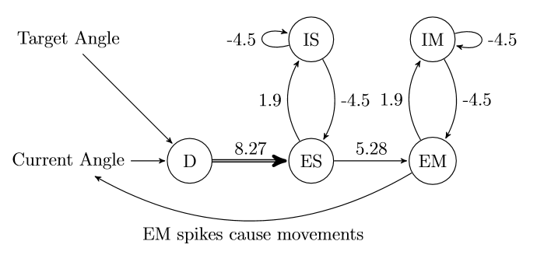
The Model

Slide 23
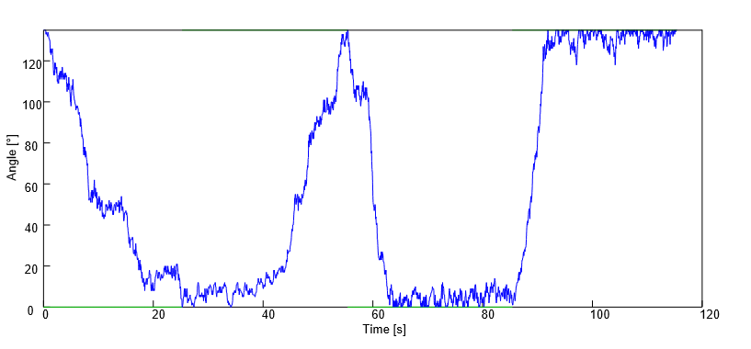
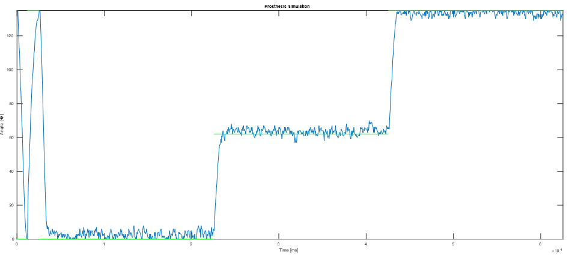
Fitness Function:
=0.1*(1-rate of wrong steps while learning)
+0.2*(1/3 for each reached angle)
+0.7*(normalized RMSD in simulation part)
Fitness: 0.93354 Approx RMSD= 13°

Slide 24
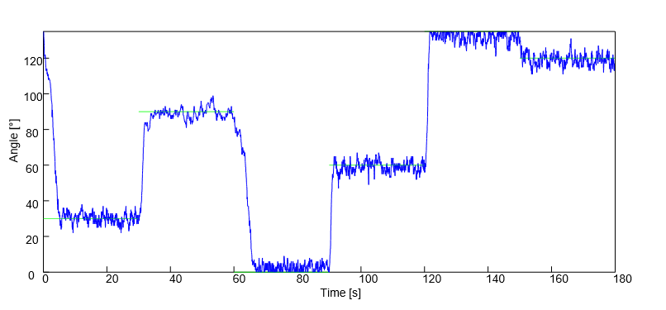
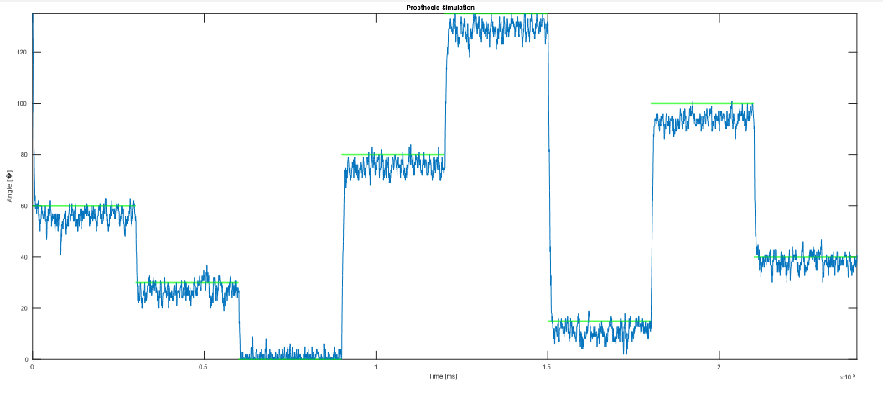
Approx RMSD = 13°

Slide 25
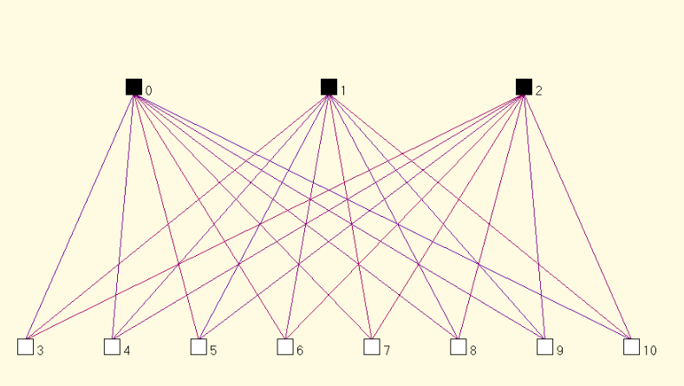

Slide 26
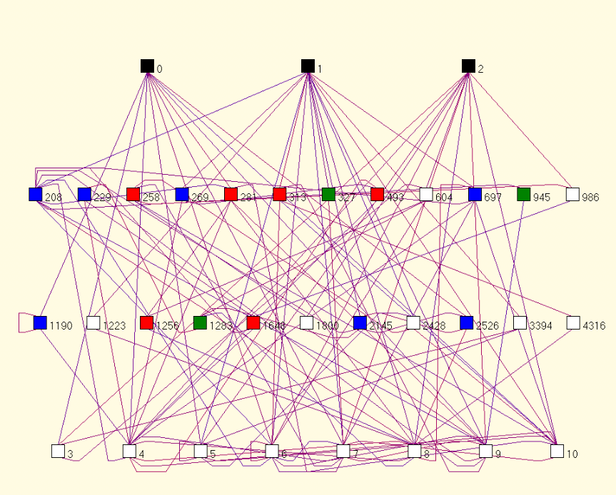

Slide 27
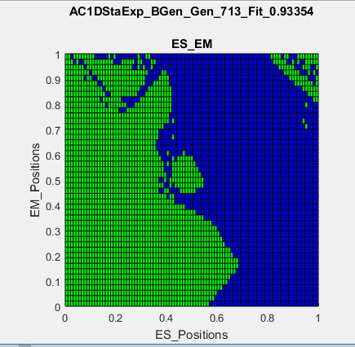
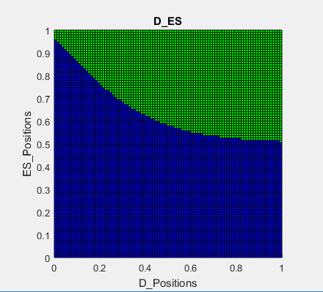
CPPNs

Slide 28
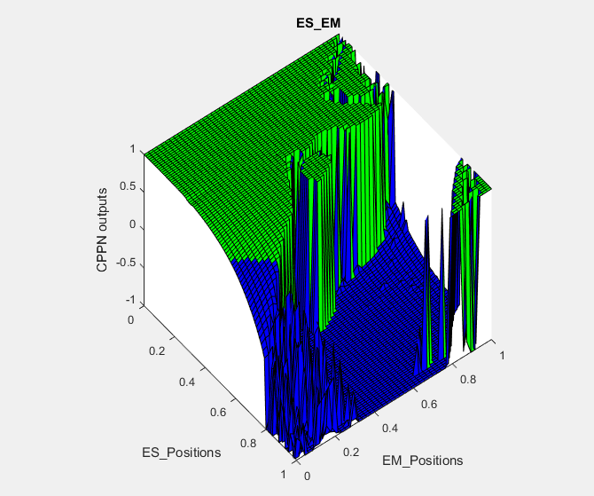
CPPNs

Slide 29
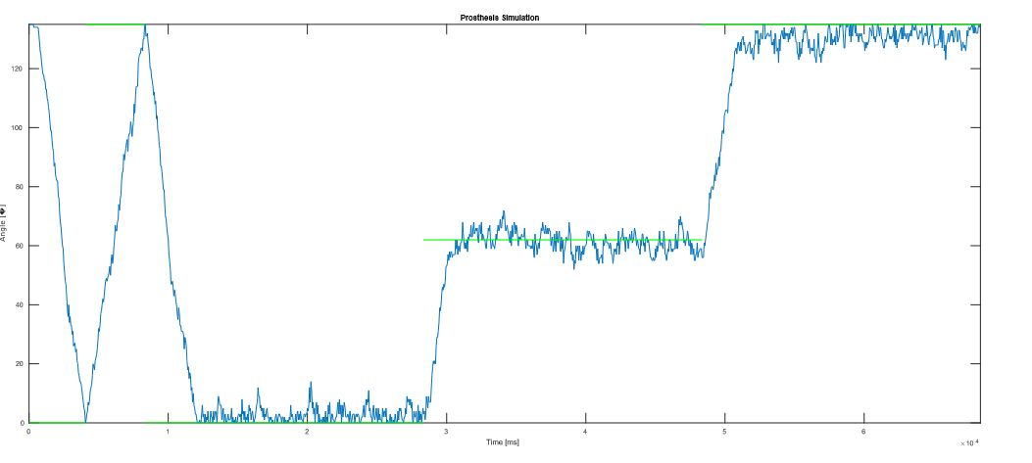
D-ES Connections 1D Substrate

Slide 30
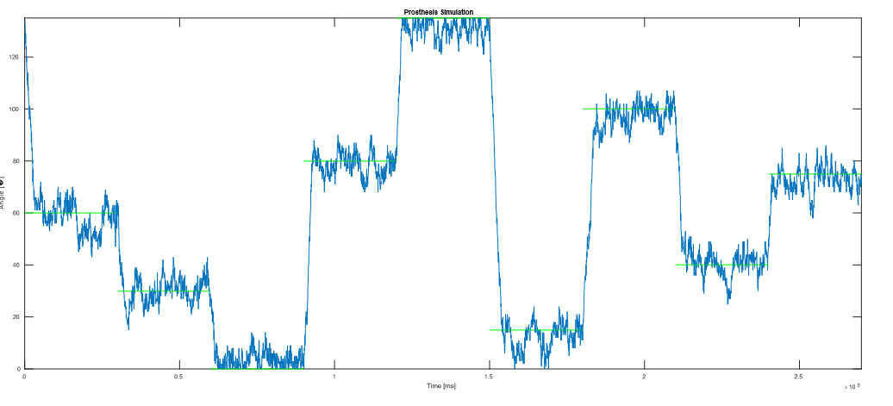

Slide 31
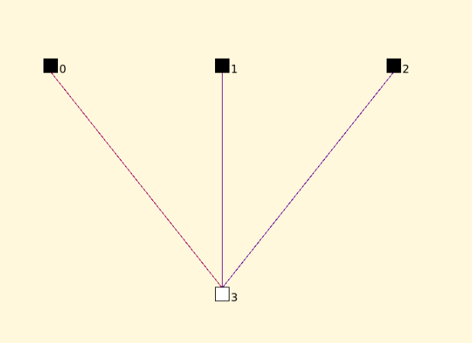
D-ES Conncetions 1D Substrate

Slide 32
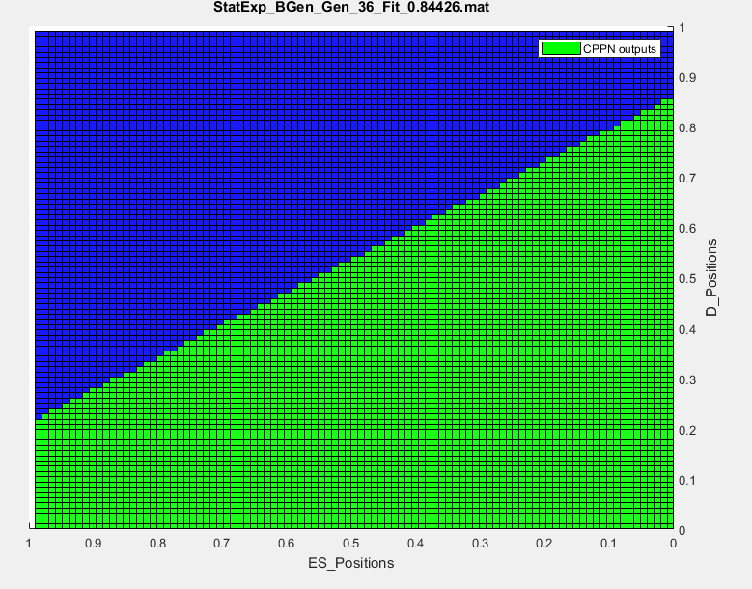
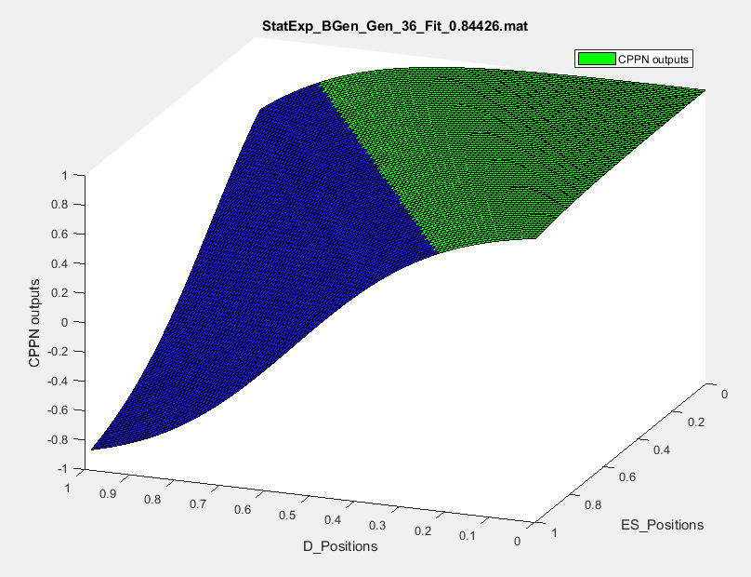
D-ES Conncetions 1D Substrate
ES und D Beschriftung vertauscht

Slide 33
Weitere Arbeit
Es-Hyperneat (rechnet im Moment)
Zufälliges Rauschen reaktivieren:
  overfitting vermeiden → womöglich geringere Varianz.
  Gute Lösungen können mit Pech in der Suche verloren gehen.
  Stabilere Lösungen werden gefunden
Skalierung: Anzahl der Neurone die im Substrat vergößern, verkleinern. Verhalten analysieren.
Ähnliche Strukturen der CPPN Funktionen.
  Wurden bestimmte Verknüpfungen immer gleich realisiert?
Ähnliche Strukturen in den von Es-Hyperneat erzeugten Netzwerken.
Vergleiche
  Test ob Hyperneat besser als der Zufall
  Vergleich mit Daten von Sebastian.
    Funktioniert hier ohne das zufällige einfügen von Neuronen. → hat bei ihm garnicht funktioniert
    Duchschnittliche Winkelabweichungen vergleichen
    ...

